Slide 1
How will I know if my child is doing well at school?
Life After Levels

Slide 2
No More Levels
Focusing on what children need to learn next, rather than focusing on what level label to give them
Encouraging a deeper understanding of an area, rather than focusing on moving up to the next stage

Slide 3
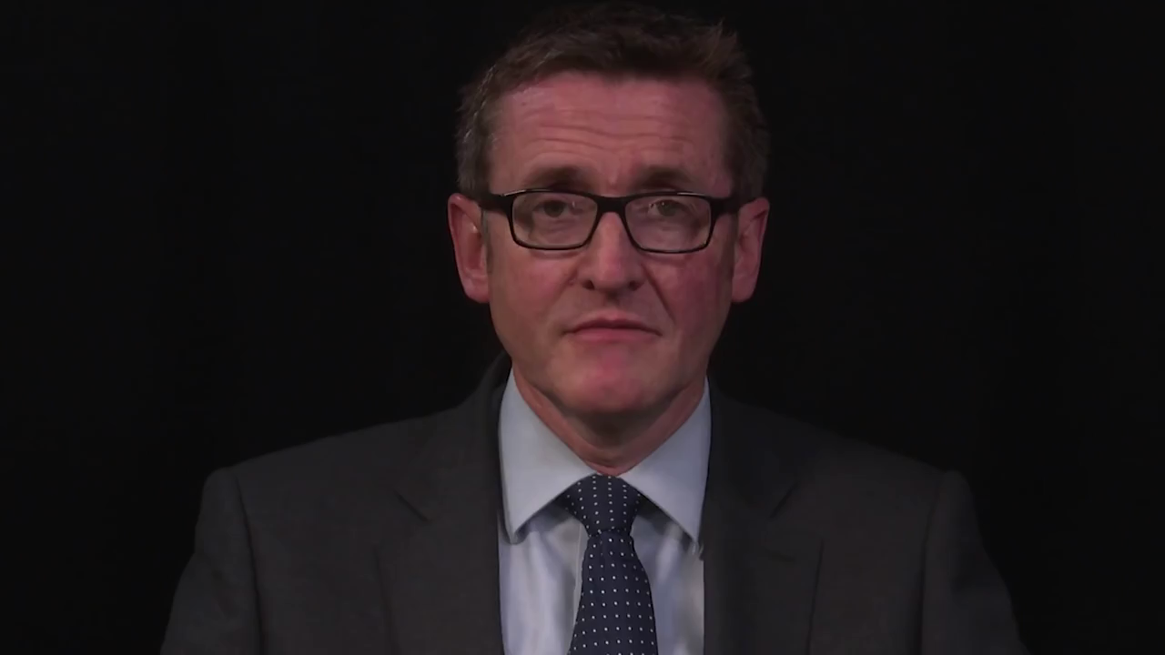
What do Ofsted want?

Slide 4
Early Years and Foundation Stage
New Baseline Assessment – Mrs Budd
By 2022, progress will be measured for year 6 from their baseline score

Slide 5
End of Key Stage 1 (year 2)
Pupils will complete tests in Maths, Reading and Grammar, Punctuation & Spelling
Pupils will be given a teacher assessment standard based on test outcomes (where appropriate) and work over the year for Maths, Reading, Writing and Science, against selected National Curriculum objectives (Interim Assessment Framework)
Standards for Maths, Reading and Writing
  Working towards the expected standard
  Working at the expected standard
  Working at greater depth within the expected standard
Standards for Science
  Working at the expected standard

Slide 6
End of Key Stage 2 (year 6)
Tests
Pupils will complete tests in Maths, Reading and Grammar, Punctuation & Spelling
Pupils will be given a test standard for Maths, Reading and Grammar, Punctuation & Spelling
    Results will be given as a raw score (test results) and then scaled score with 100 being the “expected standard”
    They will either be “at expected standard” or “not at expected standard”

Slide 7
End of Key Stage 2
Teacher Assessment
Pupils will be given a teacher assessment standard for Maths, Reading, Writing and Science against selected National Curriculum objectives (Interim Assessment Framework), based on work throughout the year
Reading, Maths and Science Standard
  Working at the expected standard
Writing Standards
  Working towards the expected standard
  Working at the expected standard
  Working at greater depth within the expected standard

Slide 8
Year 1, 3, 4 and 5
Pupils will be given a teacher assessment standard based on work completed and assessments made throughout the year against National Curriculum objectives
Standards for Reading, Writing, Maths and Science
  Working below the expected standard
  Working towards the expected standard
  Working at the expected standard
  Working at greater depth within the expected standard
If your child is working below the expected standard, you may receive some information on their performance in relation to the objectives from the year group below

Slide 9
Reporting
Currently working on a new report format for the mid-term and annual reports
What information do you value from your child’s report?
What other information would be useful in your child’s report?

Slide 10
Finally…
Still changes being made by the Government to AWL – we will keep you posted.
Our focus remains on teaching your children what they don’t yet know
We aim to be creative in our approach to educating your child and aim to make learning something that they enjoy

